Slide 1















Research project of Nissan Dataset
Presented by Swetanshu Chakladar

Slide 2
Table of Contents
Description of the dataset
Explanation on models that have bad condition
Name the models having max performance and good condition
Amount of female customer having varied condition of their vehicles
Counting the amount of orange cars
Models having high price and high performance

Slide 3

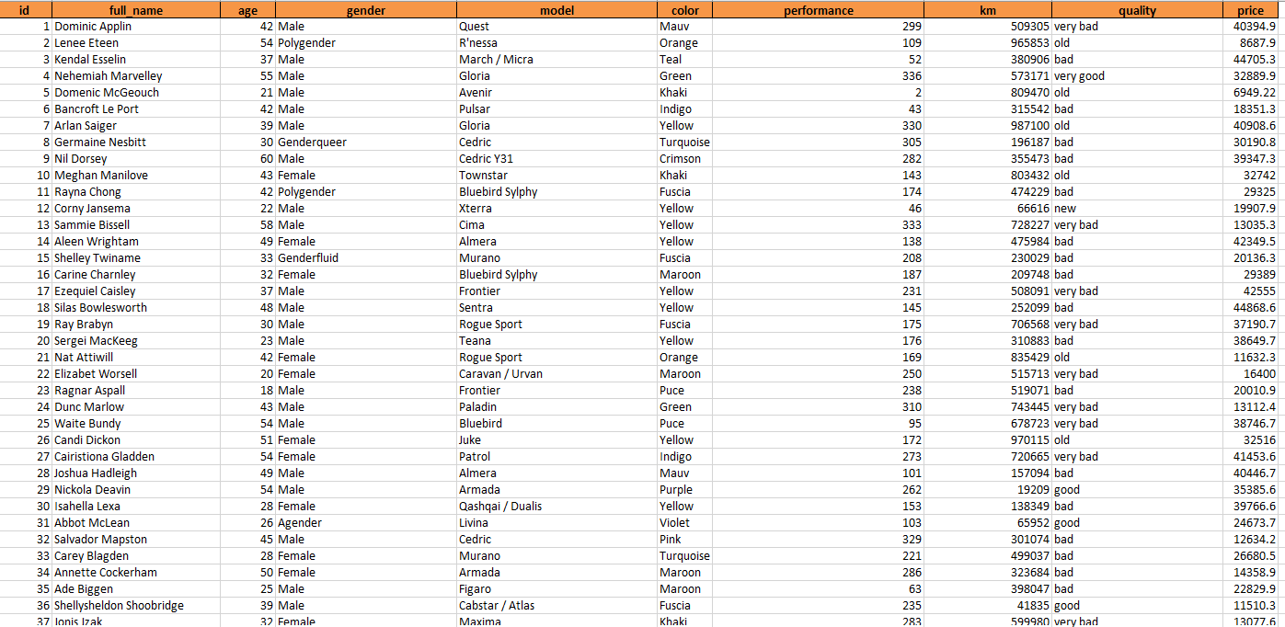
Description of the dataset
The dataset considered is based on Nissan
The dataset have full name of age and gender of the customer buying different product
The dataset also have model name with their color, performance and the km that the models give
Also the dataset provides the quality and price

Slide 4

Explanation of models based on bad condition
From the first query, model and quality is selected
The where clause is used to set a condition "Bad“
This query is showing different models that are having bad condition

Slide 5

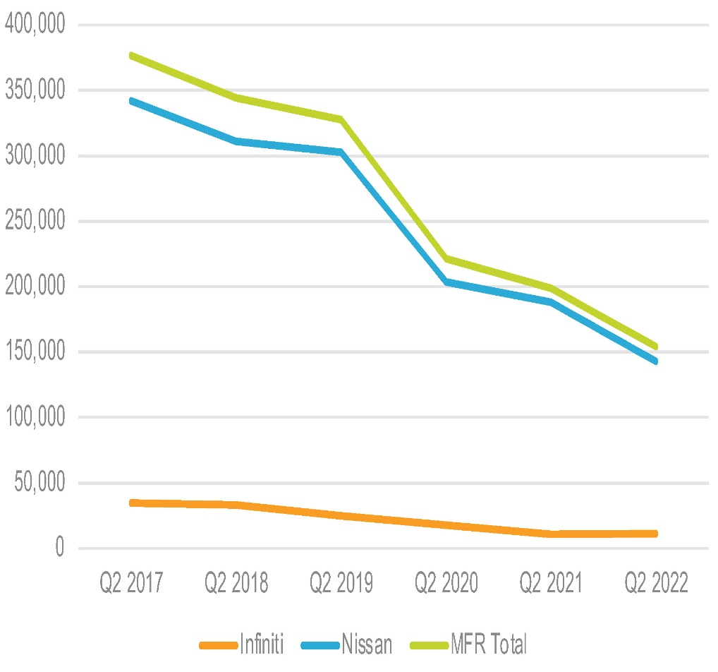
Name the top 5 models having high performance and good condition
This query states the models based on high performance and the condition is good
Limit 5 is used to understand the car that only have the high performance
There will only be one model that will be having high performance among the other models.
The graph shows how some of the models of Nissan is increasing their buisness

Slide 6
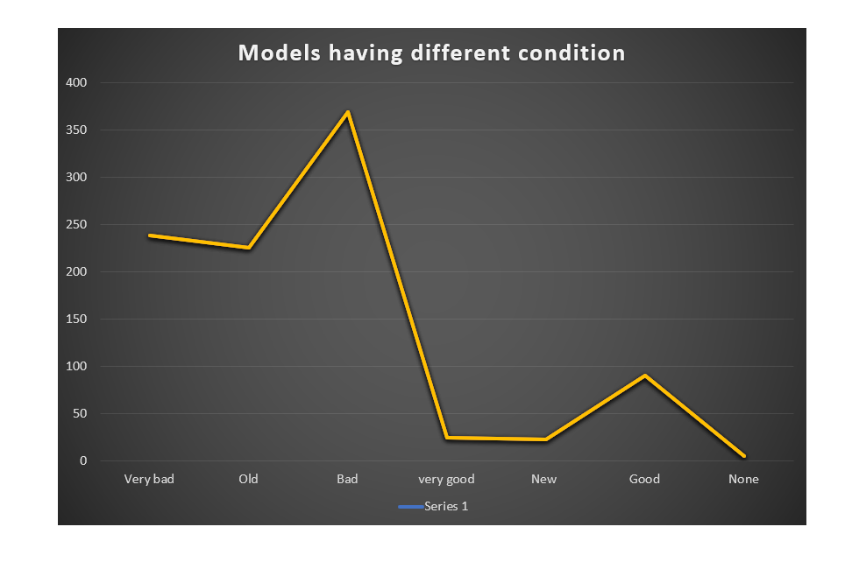
Amount of female customer having varied condition of their vehicles
This query states that in the entire dataset
The count of model gives the number of models that are damaged
Among different gender the female gender is separated to get the information on the condition of the models that they own
The model column is shown separately as well .

Slide 7

Counting the amount of orange cars
Then the query was written to get data on the amount of orange cars
Now there are same models which is identified by the number
The orange colour of different models are there which are sorted

Slide 8
Models having high price and high performance
Then another query shows which model have the highest price
Models having high performance and high km
This query shows how different models based on high price
To show the customers models having high performance the query is written so that they get the idea of price for the cars

Slide 9
Thank you very much!

